Slide 1
DT
Session 3
Behaving and Experiencing
Exploring and analyzing
Inspiring and generating
Prototyping and playing design games

Slide 2
Behaving and Experiencing
For user, customers and others such as employees the value of services is the integration of their interactions with and experiences of organizations over time
The behavior-lens on people’s activities focuses on what goes on in people minds and how this drives what they say., know, feel and do
The socio-cultural or practice lens sees people’s habits and routines as resulting dynamic mixtures of collective meanings (stories), bodily and mental activities (skills), and materials and infrastructures (stuff)
Service innovation involves changing practices, resulting in different experiences for users and customers, in which they behave differently

Slide 3
Mapping the user experience
Using this method helps n team understand holistically the interactions with a service or organization from the perspective of a user, customer, stakeholder or employee
It helps clarify what the experience is made up of, for that individual, allowing the team to identify important patterns and pain points
You can use this method and the template to describe existing experiences, or to describe future experiences
It also reveals important pain points and gaps that can become opportunities for improvement or innovation
Repeating the e.xercise for different user segments brings into view differences in process and outcome for particular groups
How:
Focus on one customer type at the time
Perhaps experiment with the extremes like easy and difficult customers

Slide 4
Mapping the user experience
Who’s experience | Time >>>
 | Find out about It | Decide to engage | First interaction with or use of the service | Later Interaction | Ending/closing
What the person does, intends, knows, says, feels...
Touchpoints and devices the person interacts with -eg website, apps...
Where the interactions happen..,
How it feels
Other people involved - eg service staff, family and friends, bystanders...
Why the user is interacting with the service.,,
What using it means for the person...
Issues in how things are
Opportunities How they could be different

Slide 5
Creating a persona/story world
This method helps a group understand the world holistically from the perspective of a user, customer, stakeholder or employee
It helps clarify what his or her world is made up of, allowing the team to share knowledge and identify important patterns
Help us to further refine our understanding about our user types
Document and summarize our findings from the Empathy Map, Points of View and User Story Boards

Slide 6
Creating a persona/story world
The backstory My family, study and work background... |  | Current situation My name is...My age is,,. Live in... with... How and where I spend my time… My work and income…
Needs… Explicit and implicit needs… | Key insights… |  | Capacities and resources I can easily... I can't easily.., My skills are... because...
Goals and values The future I want Is.. because | Issues, challenges and workarounds | Strong ties with... People, places and organizations | Beliefs about change How I think about the future...
“I think, feel, know…” | Relationships with organizations Formal/informal., .occasional/frequent | Weak ties with... People, places and organizations | Devices and technologies Things I have with or around me (eg car, TV, mobile phone)... because...

Slide 7
Exploring and analyzing
Problem findings problem settings, deciding on a research approach and making interpretations to understand an issue in more depth are habits organizations can practice
Big data reveals large-scale patterns about behaviors
Thick data helps make sense of patterns by explaining the meanings and identities that shape and are shaped by people’s behaviors and collective cultural practices.
Open data initiatives introduce new actors and new capabilities into service ecosystems

Slide 8
Segmenting by meaning
If you do not have access to people trained in qualitative research, this method helps create a framework distinguishing between key users, customers, employees or stakeholders
The main idea is to divide up people based on understanding the meanings, identities and habits that shape - and are shaped by - interactions with actors in an innovation ecology

Slide 9
Segmenting by meaning

Slide 10
Opportunity mapping
This method prompts a team to crystallize its under standing of changing socio-cultural practices and behaviors, and other drivers of change over a specific time horizon
It produces a simplified framework that orders the team's current understandings and assumptions
It brings into view the relationships between changing behaviours and other changes in the operating environment and involves a group in collective sense making
It surfaces important points of agreement and disagreement among members of a team
How:
Explore the shared issue. Introduce the issue you aim to address using your current research materials.
If you have visualized drivers of change or created persona story worlds, have these available for people to explore and share.
Ask people to share their perspectives on how change happens. Identify the time frame over which you are considering change.

Slide 11
Opportunity mapping
What's the time horizon over which you are thinking about change? e.g. 3 years 4-5 years 5+years 6-10years Longer | The operating environment is changing from one situation…. | . . .to something else
What's driving change? Needs Costs Change in business env. Change in regulatory env. New technology …
 | People’s behaviours and capabilities are changing from this to… | . . .to another
Things you don't know and assumptions you are making
Identify key shifts in behaviors. Review the research available about how people's
behaviors are changing. These might not be existing users or customers but could be other groups of people.
Aim to simplify these shifts into statements of the form "people's behaviors are changing from this"
to "something else". Produce several of these pairs, and then together agree one or two that seem more important or relevant to the issue you are aiming to address.
This will be for the y axis.
Identify a key driver of change. Share views on what is changing in the wider operating environment over the relevant time horizon.
Simplify some of the complex data or opinions you have into the form "the operating environment is changing from one situation" to "another
situation". Produce several of these pairs, and ask participants to select one or two of them that are most important or relevant.
This will be for the x axis.

Slide 12
Opportunity mapping

Slide 13
Problem/proposition definition
This method prompts a team to clarify its understanding of an issue, reflect on how it is framed, clarify who it is an issue for, and explore how a possible solution relates to this problem and the impacts it might have
Brings into view what the issue is represented to be and a possible solution to it at a particular moment in time. Prompts a team to link generating concepts for solutions, to representations of problems
Use this method after solution concepts have been suggested, to clarify how they relate to the Issues to which they are a proposed solution

Slide 14
Problem/proposition definition
Proposition definition It's a... (kind of thing) That is/has... (characteristics) Which results in... (the change we want to lake place) | User segments Aimed at/co-created with... (the target user segment(s)) Who want/need to... (purposes, tasks) And are able to... (capacities) And who benefit because... (outcomes)
Problem/issue definition Addressing the issue of... Which is shaped by... (social, economic, other factors) For which we have evidence that shows that (research findings) Which matter because... (insights) And which we are framing as a... (kind of issue/opportunity) | Organizational/wider resources Which is resources and co-created by involving... (organizational and other resources) Resulting in... (organizational and/or social outcomes)

Slide 15
Problem/proposition definition

Slide 16
Inspiring and generating
Creativity during designing innovative services is distinctive because service innovation concepts are multiple, temporal and involve many actors
Inventive habits for service innovation are:
Making the strange familiar and the familiar strange
Moving between excess and simplicity
Zooming in and zooming out
Connecting and disconnecting
These habits open up the tensions between the particular and the general

Slide 17
Inventive habits for service innovation are:
Making the strange familiar and the familiar strange
Moving between excess and simplicity
Zooming in and zooming out
Connecting and disconnecting
Methods:
Sketching
Telling stories

Slide 18
Prototyping and playing design games
Exploratory prototyping brings a future innovation ecosystem into partial view and creates concepts and actions that shape value-in-use
Design games involve participants in creating concepts and activities that connect how things are done now with new capacities and resources resulting in future practices
Blueprinting helps different organizational functions see how their activities and capacities co-create value-in-use for different actors in an innovation ecosystem
Role play stimulates creativity by getting people to approach things in new ways

Slide 19
Prototyping
Be inspired by your materials
Prototype to test your assumptions
Use what you have
Start DOING rather than planning
Why do we prototype?
Eliminate risk early in the project
Fail cheap, learn early and fast
Turn failures into learning
Remember:
Experimentation as valuable way to rapidly learn
Start sooner than you thin you are ready
It is NOT a beautiful miniaturized version of your final solution

Slide 20
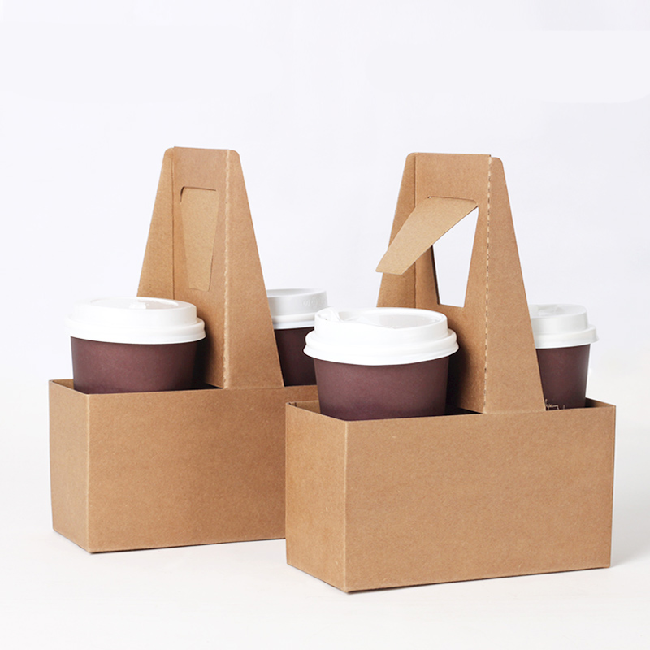
Let’s prototype…
You have 5 minutes to build a:
A cup holder, which can hold a minimum of 3 cups of coffee
Time starts now

Slide 21
The mindset of prototyping
Prototyping is a way of working
Its NOT the thing you made, but the attitude you took towards making it
Showing incomplete work
Building to think rather than thinking to build
Think prototyping, not prototype
Iterate your concept on the fly
Experimentation is valuable
Allow yourself to be inspired by whatever materials you have on hand
Starting before you think you are ready
Enlightened trial and error often outperforms precision and advance planning

Slide 22
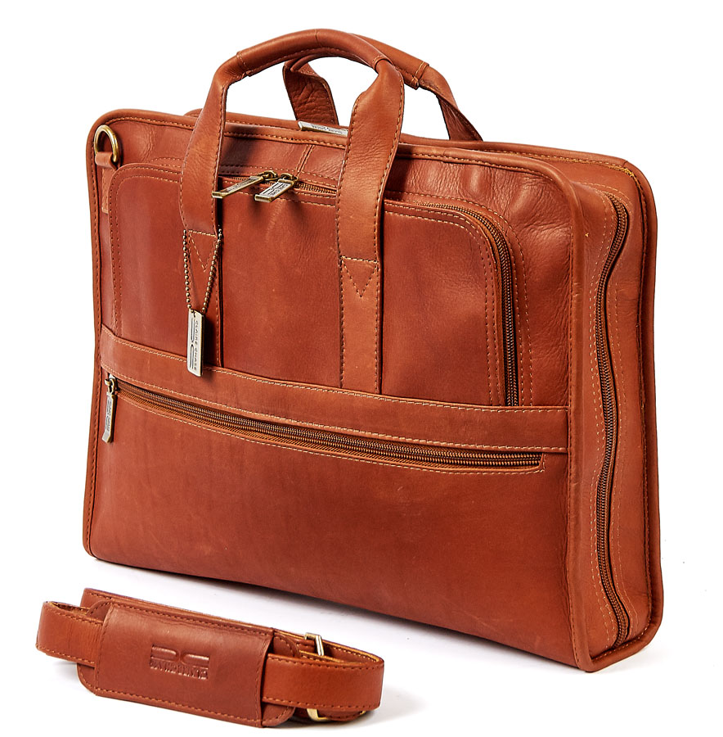
Let’s prototype…
You have 10 minutes to build a:
Briefcase of the future, which
Time starts now

Slide 23
Analysing Prototyping
Findings:
Observations you have made, things you have noticed
Insights:
What these tell you
Concepts:
Possible opportunities or ways to do things differently
Questions:
What you want to explore further through prototyping or design games
Methods:
How you might carry out the exploration

Slide 24
Prototyping metrics:
Talking vs. doing ratio
Time to build
Number of prototypes
Amount of laughter
Number of failures exposed
New or unexpected questions raised
Ideas generated

